Slide 1
Multimedia Authoring Programs
Unit D

Slide 2
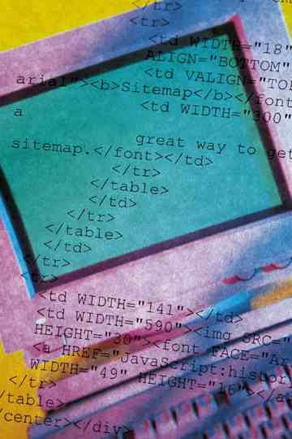

Objectives
Multimedia Authoring Programs
Slide Show Programs
Card or Book Metaphor Programs
Icon-based Programs

Slide 3

Objectives
Time-based Programs
Programming Languages
Scripting Languages
Web-based Multimedia Development Programs

Slide 4
Multimedia Authoring Programs Tasks
Produce content with paint, text, and animation tools
Design screen layouts using templates
Create interactivity
Incorporate text, graphics, sound, video and animation
Create hyperlinks
http://www.course.com

Slide 5

Multimedia Presentations
Presenter and audience
Don’t usually use authoring programs
Presenter has control; can have interactivity
Similar to slideshows, but more sophisticated
Can be developed easily, quickly and inexpensively

Slide 6

Interactive Titles
One-on-one situations (simulations, games)
Users have control for interactivity
Programs can make decisions based on user performance
Developers must address several design, navigation and “what-if” issues

Slide 7

How Do You Choose an Authoring Program?
Do they create presentation or interactive titles?
Which platforms will be used for development and playback?
What interface will be used?
What features does the package include?
Can the package create Web applications?
What is the learning curve involved?
What is the price?

Slide 8
Categorizing Multimedia Authoring Systems
Based on
metaphor
used
Electronic slide show
Card stack or book programs
Icon-based programs
Time-based programs

Slide 9

Slide Show Programs
Show slides one at a time
Similar to overhead transparencies or 35mm slides
Intuitive (simple) systems
Can include multimedia elements and hyperlinking
Microsoft PowerPoint and Corel Presentations

Slide 10

Slide Show Program
Advantages
Inexpensive
Easy to learn
Easy to use
Provide templates
Cross-platform capability
Can play on systems without the software

Slide 11
Slide Show Program
Disadvantages
Mostly linear
Mostly non-interactive
Not attractive for interactive titles

Slide 12

Slide Show
Delivery
Self-running (through kiosk)
Distributed on CD to users
Played from Internet
Can supplement Web-based lectures

Slide 13
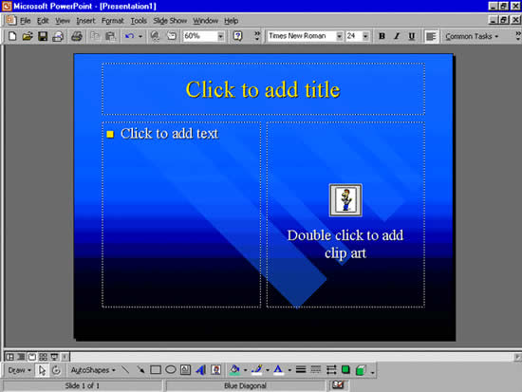
Microsoft PowerPoint Terms
Presentation
Slide
Objects
Development environment

Slide 14


Microsoft PowerPoint Features
Design templates
Auto layouts
Autoshapes
Customization
Animation
Multimedia
Views: normal, outline, sorter, slide show

Slide 15

Card or Book
Metaphor Programs
Create interactive titles
Advantages:
  Easy to understand metaphor
  Easy to use
  Provides templates
Disadvantages:
  Not always cross-platform
  Some program features not very powerful

Slide 16

Hypercard Authoring Program
Developed in 1987 on Apple computers
  Develop cards with different elements associated with them
  Put cards in stacks
  Link the cards with buttons to jump to a different card
HyperStudio is a more recent version

Slide 17

Toolbook Authoring Program
Based on a book metaphor
Author level creates the title
Reader level interacts with the program
Developed by Asymetrix
Easy to use

Slide 18
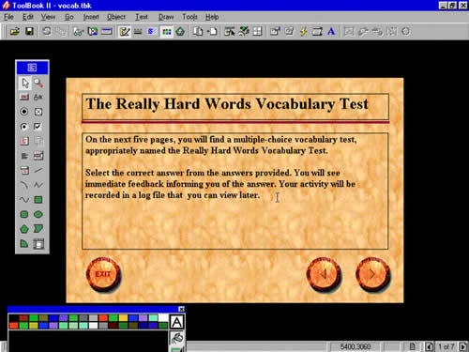

Toolbook Example
How viewer sees it
How developer sees it

Slide 19

Toolbook Terms
Book
Page
Object
Properties

Slide 20
Toolbook Features
Template
Animation editor
Media Player
Coach
Catalog
OpenScript
Distribution

Slide 21

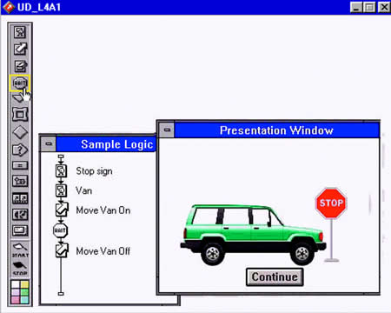
Icon-Based Programs
Flowchart scheme
Each icon represents
  Content
  Particular event
Advantage: see the flow/structure of program
Disadvantage: less intuitive, more expensive

Slide 22
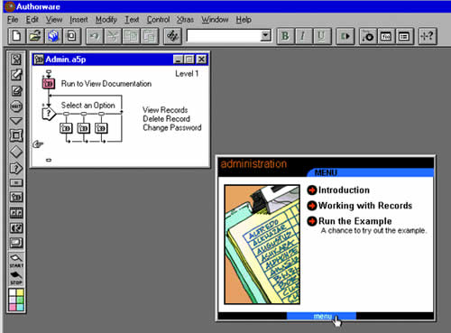
Macromedia Authorware Terms
Application
Design Window
Presentation window
Flowchart
Flowline
Icons
Knowledge objects

Slide 23


Macromedia Authorware Features
Drag and drop
Text and graphics editing
Text search and spell check
Knowledge Object wizard
Path animation
Data tracking
Packaging
Web packager

Slide 24

Time-Based Programs
Uses a movie metaphor
Plays movie until an action causes it to stop or pause
Allows branching to another part of movie
User has control

Slide 25
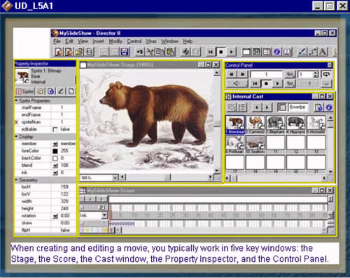

Macromedia Director Terms
Movie
Stage Window
Score Window
Cast Window
Cast Members
Sprite
Channel
Frames
Lingo

Slide 26

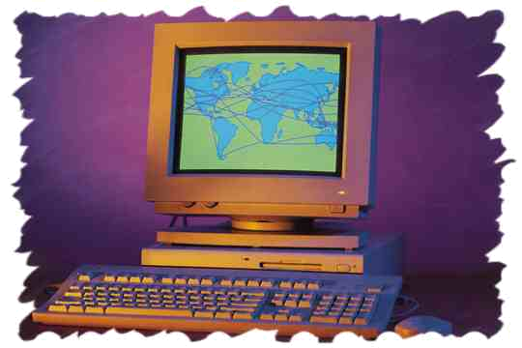
Macromedia Director Features
Animation
Property inspector window
Paint window
Cast manager
Projector
File format support
Multi-user support
Web delivery

Slide 27

Programming Languages
Creates programming code
C++ (most popular)
Visual Basic
Perl
Java (Web)
JavaScript (Web)

Slide 28
Programming Languages
Advantages:
  Flexibility
  Lets you tailor the application
  Ability to run on different platforms
Disadvantages:
  Not specifically designed to create multimedia applications
  More difficult and time-consuming

Slide 29

Java Language
Developed by Sun Microsystems
Capability of being cross-platform
Can create animations and search databases
Can extend functionality of HTML with Java applets

Slide 30

Java Applets
Small programs developed for a specific purpose
Can be shared with other applications, especially on the Web
Downloaded to user machine from Web server

Slide 31

Java Applets
Can create your own if you are an expert
Custom codes available from:
  User groups
  Sun Microsystems & other developers
  Third-party developers
  Free from the Web

Slide 32
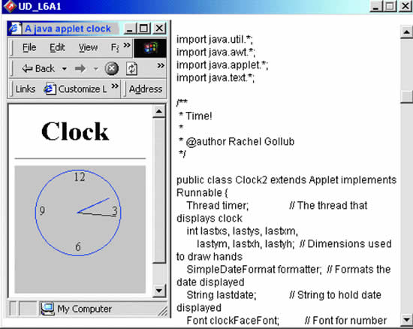
Java Applet Example

Slide 33

JavaScript
Scripting language for Web interactivity
Mouse rollovers
Can interact with a Java applet
  JavaScript creates dialog box
  User enters text
  Java applet checks the text and modifies the font to fit on the screen

Slide 34

Common Gateway Interface
CGI is a specification for programming languages
Programs run on the server
Can obtain and return information to the user
Example: Web searches

Slide 35

HTML
Standard for creating web pages
Markup (not programming) language
Uses tags to mark elements
Browser interprets these tags to display the web page
More limited than programming languages
Cannot create multimedia applications, but can incorporate these elements into web pages

Slide 36

Scripting Languages
Programming languages that create scripts
A script is program code for a specific task

Slide 37
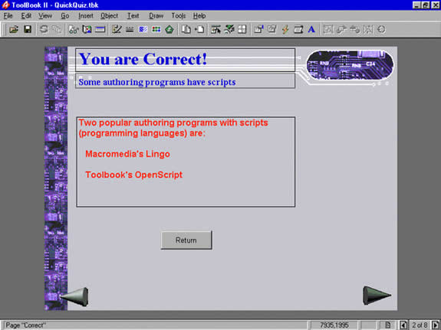
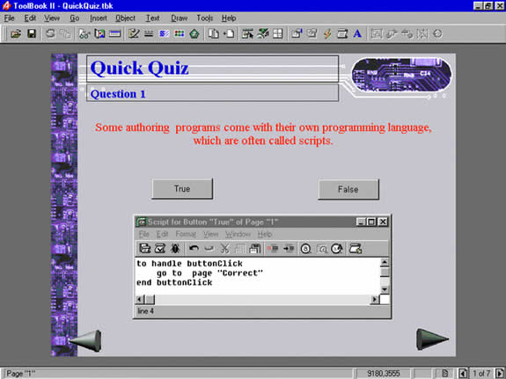
Scripting Language Example

Slide 38
Authoring Programs and Scripting
Authoring program creates programming code automatically
Authoring program has its own scripting language for
  Accessing external media (CD-ROM)
  Creating interaction
  Controlling speed of animation, etc.

Slide 39
Toolbook’s OpenScript Example
Buttons (action to take if user clicks on it)
Developer would select the correct button on the screen and create this script
  to handle buttonClick
    go to page “Correct”
  end buttonClick

Slide 40

Macromedia Director’s Lingo Rollover Example
  if rollOver(5) then
    put “Roadster” into field “Message”
  end if

Slide 41
Multimedia Development Steps
Plan your title
Select or create your template
Choose a layout
Add special effects
Assign properties
Test the application
Save it in appropriate delivery format

Slide 42
Web-Based Multimedia Development Programs
Macromedia uses Shockwave player for Web delivery of Director and Flash movies
Microsoft uses ActiveX Controls for multimedia on the Web
Most players can be downloaded for free

Slide 43
Preparing/Playing
Director on Web
Step 1: Publish in compressed format
Step 2: Insert compressed file into HTML document
Step 3: movie file and HTML uploaded to server
Step 4: User views movie on web using Shockwave player
  <embed src=“mymovie” width=“200” height=“45”> </embed>

Slide 44

Delivering to the Web
Macromedia
Director Shockwave Studio allows CD-ROM, DVD and Web delivery (Publish option)
  Flash delivered on Web
Can “Save As Web Page”
PowerPoint

Slide 45
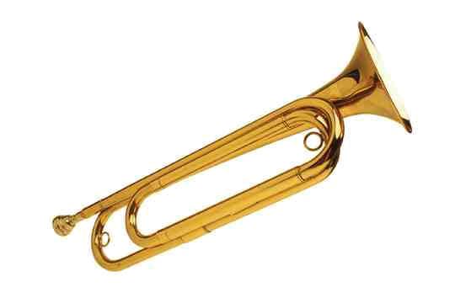
HTML Code for Audio
<A HREF=“jazz.wav”><IMG SRC=“sax.gif”></A>
<BGSOUND SRC=“jazz.wav” loop=5>
<EMBED SRC=“jazz.wav” width=144 height=74>

Slide 46

Issue: Censorship
Rating software titles, games, web sites
1996 – Communications Decency Act
  Passed and then overturned
Should multimedia be censored?
Who would control it and how?

Slide 47
Multimedia Authoring Programs
End

